Slide 1

How Long Will It Take? Forecasting Project Duration with Machine Learning
DSCS Case Competition
Maryam Ahmed

Slide 2
Table of Content
01
02
Data Cleaning & EDA
Introduction
Models & Results
03
04
Key Findings & Conclusion

Slide 3
01
Introduction

Slide 4
Facts
30% of Construction Projects Exceed Their Estimated Time by 40%! $1.6 Trillion Lost Annually in Construction Delays
What if we can anticipate this?
Notes:
Did you know that over 30% of Construction Projects Exceed Their Estimated Time by 40%! Ss reported by mckinsey that’s over $1.6 Trillion Lost Annually in Construction Delays
What could we do if we can anticipate this?
Source: https://www.mckinsey.com/capabilities/operations/our-insights/reinventing-construction-through-a-productivity-revolution

Slide 5
Problem Statement
Classifying Duration of a Project
This approach provides value to decision-makers:
Anticipate project completion timelines
Allocate resources effectively
Understand the pain-points of longer projects
Notes:
My project aims to develop a structured approach for classifying project durations.
This will asssit in enabling decision-makers to anticipate completion timelines, allocate resources effectively, and address the challenges of longer projects.

Slide 6
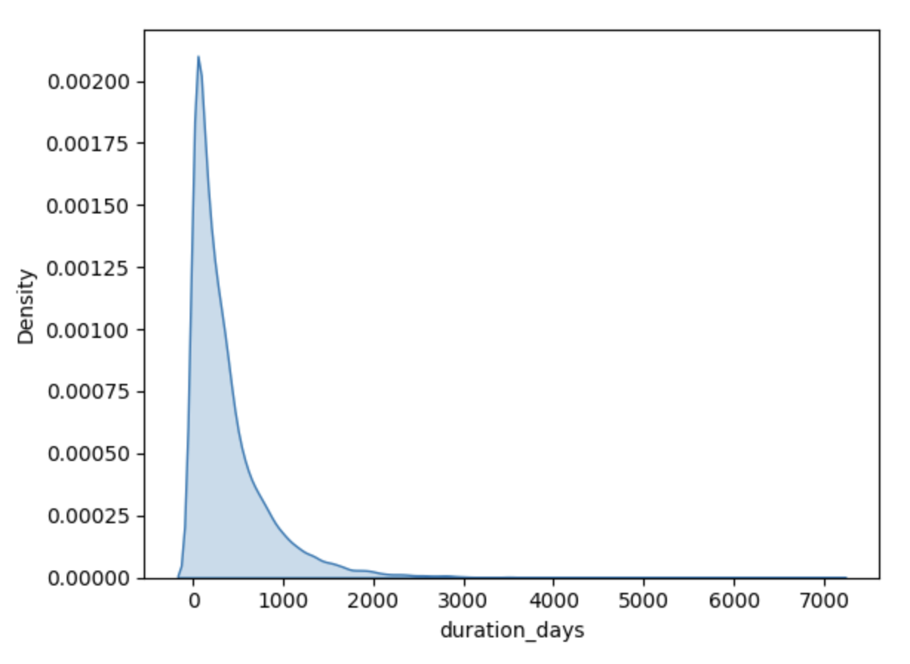
Problem Statement
Notes:
This topic arised when digging into the Urban Systems data, Looking at completed projects duration (which I calculated by the first and last day a project was billed).
The distribution is highly skewed, having projects exceed over 19 years !
It would be extremely useful to investigate why certain projects take much longer and whether they share common characteristics. Understanding what variables may require special monitoring, and lastly anticipate delays and bottlenecks in project execution.

Slide 7
Problem Statement
Classify the duration of projects
Short Term
(< 3 months)
Long-Term
(> 16 months)
Standard
(3 – 8 months)
Comprehensive(8 – 16 months)
Notes:
The approach will group projects into four main buckers, short term ….. With the ability to dig into what variables influence each timeframe.

Slide 8
02
Dataset EDA
Lets dive into the dataset!

Slide 9
Datasets
Employee
Projects
Employee ID
Hire Date
Termination Date
Rate
Project key
Project Type
Status
Source
Branch ID
Billing
Branches
Employee ID
Project key
Regular hours
Transfer Date
Category
Branch ID
Branch Name
Notes:
A quick run down of the datasets at hand. We had four datasets that were employees, projects, billing and branches,

Slide 10
Datasets
Employee
Projects
Employee ID
Hire Date
Termination Date
Rate
Project key
Project Type
Status
Source
Branch ID
Billing
Branches
Employee ID
Project key
Regular hours
Transfer Date
Category
Branch ID
Branch Name
Notes:
Which countianed 3 primary keys, employeeID, Project jey and brach, ID

Slide 11
Database
Employee
Projects
Employee ID
Hire Date
Termination Date
Rate
Project key
Project Type
Status
Source
Branch ID
Billing
Branches
Employee ID
Project key
Regular hours
Transfer Date
Category
Branch ID
Branch Name
Notes:
That where used to fead the blling dataset. However, the datasets where merged, appeneded and transformed to fill the modeling needs.

Slide 12
Dataset
Data Cleaning
Additions
Duration Bins
Employees Count – Eng vs Others
Avg Years of Experience & Rate
Avg Target Ratio
Seasonality
Billing Frequency
Avg projects/Employee
Time between billings
Contribution Ratio
Assumptions:
Status (Active, Dormant, Inactive)
Total Hours
Merging Tables
Standardization & Normalization
Multi-collinear Variables
Notes:
When cleaning the data, a few a assusmptions where made,

Slide 13
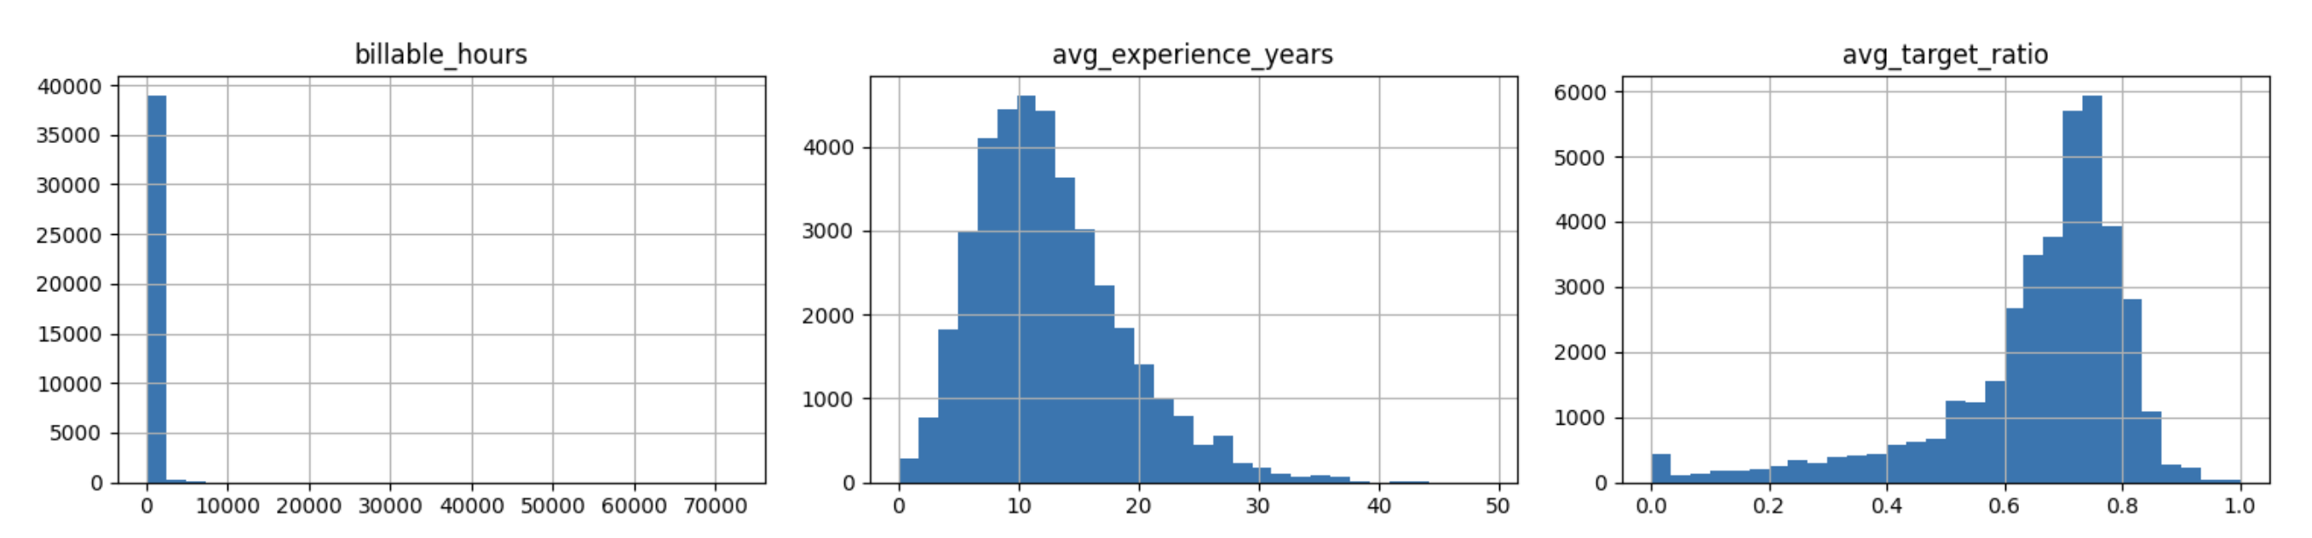
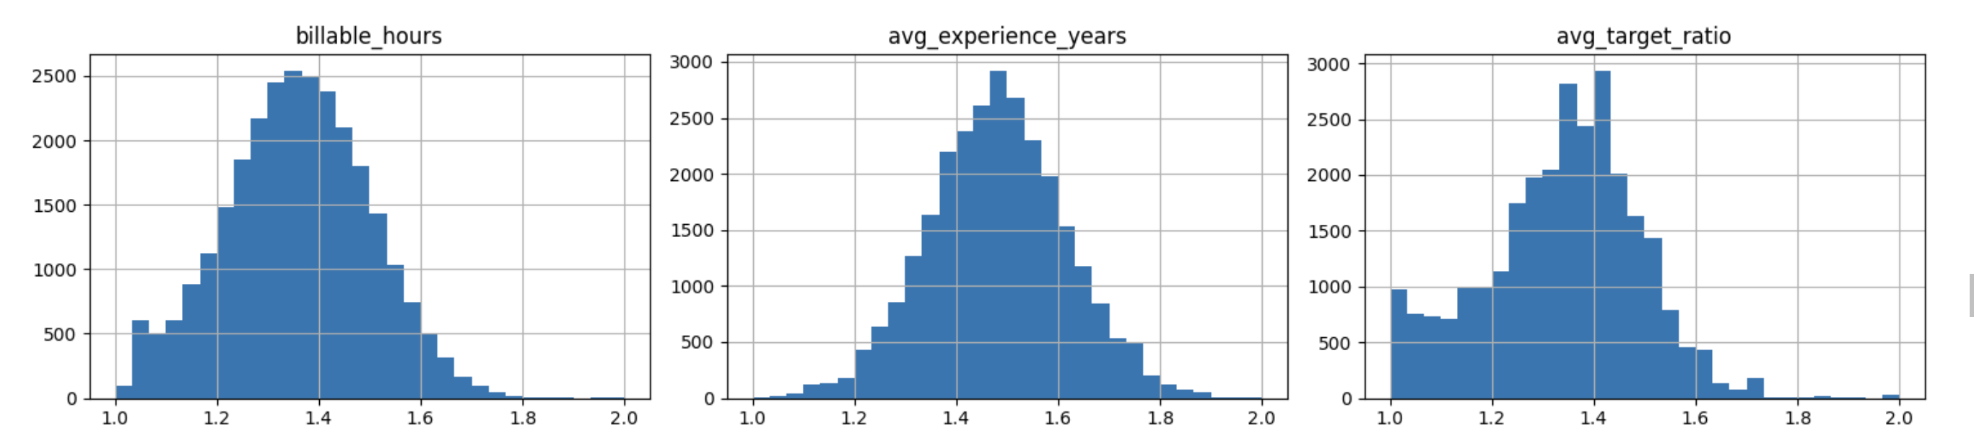
Normalization
Notes:
Normalization and scaling are important because they prevent certain features from dominating the learning process and help models converge faster and perform better.

Slide 14
Dataset
Data Cleaning
Additions
Duration Bins
Employees Count – Eng vs Others
Avg Years of Experience & Rate
Avg Target Ratio
Seasonality
Billing Frequency
Avg projects/Employee
Time between billings
Contribution Ratio
Assumptions:
Status (Active, Dormant, Inactive)
Total Hours
Merging Tables
Standardized & Normalization
Multi-collinear Variables

Slide 15
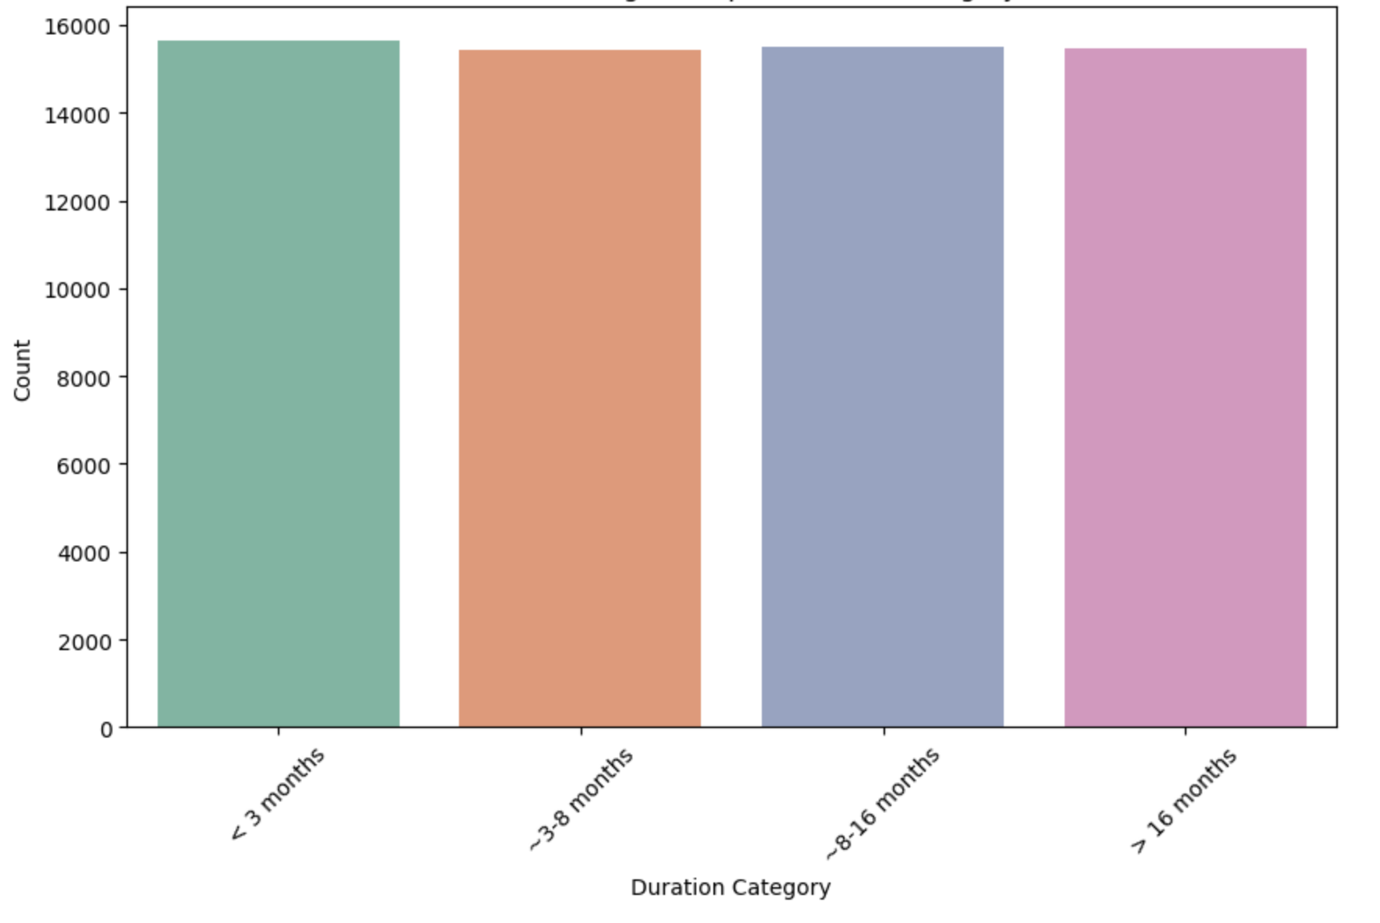
Dataset
Additions
Duration Bins
Employees Count – Eng vs Others
Avg Years of Experience & Rate
Avg Target Ratio
Seasonality
Billing Frequency
Avg projects/Employee
Time between billings
Contribution Ratio
25th
50th
75th
100th

Slide 16
Final 15 Variables
Categorical
Project Type
branch name
source
Numerical
Estimated Billable Hours
Avg. Experience (years)
Count of engineering & technical employees
Avg. Billing Frequency & Time between Billing
Avg. Projects per Employee
Avg. Contribution Ratio
Notes:
After preforming a chai square test of independence for categorical variables and looking at the strength in correlation of the numeric variables, we are left with 15 key variables used within the model,

Slide 17
03
Models
Model selection, methods, hyperparmeter tuning

Slide 18
Problem Statement
Classify the duration of a project
Short Term
(< 3 months)
Long-Term
(> 16 months)
Standard
(3 – 8 months)
Comprehensive(8 – 16 months)
Notes:
tO assess what bucket the project will fall under

Slide 19
Model Objective - Classification
Classify the duration of a project
Ordinal Logistic Regression
Support Vector Machine
Random Forest
Notes:
We dug into the key models to help classify the durations. These where selected because of their pros and cons in respective to the dataset.

Slide 20
G. Ordinal Logistic Regression
Support Vector Machine
Random Forest
Models
Advantage
Easy to Interpret
Less prone to overfitting
Dis-advantage
High-dimensional data
Advantage
Works well with high-dimensional data
Dis-advantage
Less Interpretable
Advantage
Robust to overfitting
Non-parametric
Automatic Feature Importance
Dis-advantage
Less interpretable
Notes:
Where the Generalzied Ordninal Logistic regression is create or interproablity, You are able to quantifty how much a araible impacts the probability of a project falling to any of the bins. While also being less prone to overfitting. The disadvantage and the high dimensional data, which as we dummy code all the catrgeorical variables, we are left with 48 variables which may be a lot for the model.

Slide 21
Methodology
an·a·lyze
/ˈanlˌīz/
INPUT
Classification Model
Bayes Search & CV
OUTPUT
Normalized and
Scaled Data
Assumption Tests
Analyze Performance
Set Parameter Tunings
Final Preformance Measure
Notes:
hnlHGxjLQzW78GxVD587oSzv_GlHBnUlmo1qswS62zs

Slide 22
04
Results
Model Results

Slide 23
Metrics
Accuracy | Recall (Long-Duration)
Accuracy of each classification | Recall measures how well your model identifies true positives If recall is low can lead to underestimation and financial risk.
Notes:
Recall measures how well your model identifies true positives (i.e., actual long-duration projects that are correctly classified as long).
If recall is low, it means the model is missing many long-duration projects and misclassifying them as shorter, leading to underestimation and financial risk.

Slide 24
Metrics
 | Accuracy | Recall
G. Ordinal Logistic Regression | 86% | 89%
Random Forest | 88% | 90%
Support Vector Machine | 89% | 90%

Slide 25
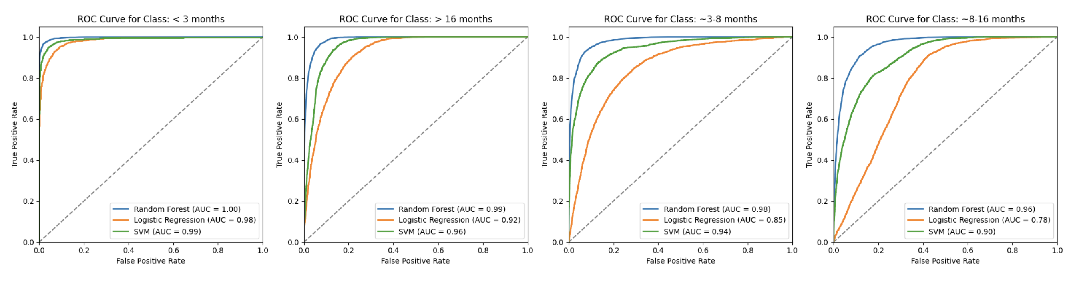
ROC
Notes:
A ROC (Receiver Operating Characteristic) curve is a graphical representation used to evaluate the performance of a binary classification model across different threshold settings. optimal balance between true positive and false positive rates,
A perfect classifier would achieve a TPR of 1 (all positives correctly identified) with an FPR of 0 (no negatives misclassified), resulting in a point at the top-left corner of the plot.

Slide 26
Metrics
 | Accuracy | Recall
G. Ordinal Logistic Regression | 86% | 89%
Random Forest | 88% | 90%
Support Vector Machine | 89% | 90%
Notes:
In terms of interpretablity, I would choose

Slide 27
Metrics
 | Accuracy | Recall
G. Ordinal Logistic Regression | 86% | 89%
Random Forest | 88% | 90%
Support Vector Machine | 89% | 90%

Slide 28
05
Key Findings
What did this tell us ?

Slide 29
Takeaways & Suggestions
Decrease the Avg Projects of Employees Assigned to Long Term Projects
Increase In the avg project per employee increases the probability of a project duration being greater than 16 months by over 100%
Potential value in process improvement of IT and Landscaping Projects
Project type Information Technology & Landscape Architecture have the highest odds that fall under > 16 month,
Investigate root cause of long-term projects in Fort St John, Kamloops and Moose Jaw
Highest Odds of long-term projects
Notes:
r8q2xuMU-4Y9wLBa4xf82uI46eQhZsIuS69fE5OCBIU

Slide 30
06
Conclusion
Next steps?
Questions?
Notes:
Confirm assumptions
Dig into each category further!

Slide 31
Thank you!

